Slide 1

Select Topics in Python
Math Library Functions
Adwith Malpe

Slide 2
Agenda
Agenda
What is a library?
What is the Math library?
Demo

Slide 3
What is a library?
What is a library?
Collection of related modules that contain pre-compiled code
May contain documentation, configuration data, message templates, classes, values, and more
Can utilize functions from libraries to process data in your program
To use modules from a library, you must import the library first

Slide 4
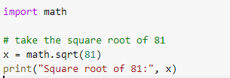
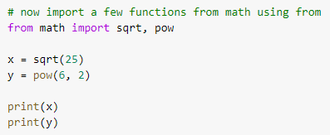
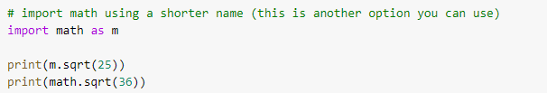
What is the Math Library?
What is the Math Library?
Library that provides access to mathematical functions defined by the C standard
Math library can’t handle complex numbers
Use the cmath library to handle complex numbers
All return values are floats except when explicitly noted

Slide 5
Demo
Demo

